Slide 2
Encryption
Confidentiality
Does not hide the data
Makes data incomprehensible
Notes:
Ciphertext = transforming data into gibberish

Slide 3



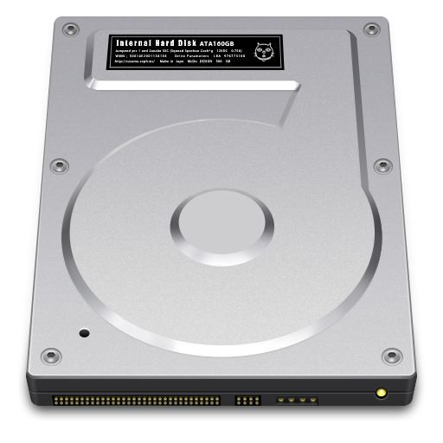



Encryption
Cleartext/Plaintext
Ciphertext
3(2$wIP0!a
This is a message!
Cipher
This Photo by Unknown Author is licensed under CC BY-SA
This Photo by Unknown Author is licensed under CC BY-SA
Notes:
Ciphertext = transforming data into gibberish

Slide 4
Ciphers - Stream
Stream
byte
byte
byte
byte
7ye)
1*d2
k#90
%ti!

Slide 5
Ciphers - Block
byte
byte
byte
byte
byte
byte
byte
byte
byte
byte
byte
byte
byte
byte
byte
byte
byte
byte
byte
byte
byte
byte
byte
byte
byte
byte
byte
byte
byte
byte
byte
byte
byte
byte
byte
byte
7%ti!y1*d2ek#90)
%t1i45@$*uyf3i*0)
%t1i45@$*uyf3i*0)
Notes:
Block of 64 Bit and higher

Slide 6
Ciphers – Stream vs. Block
Stream | Block
Plaintext to ciphertext one byte at a time | Plaintext to ciphertext in blocks (64 bits and higher)
Easier to reverse | Harder to reverse
Faster | Slower
Notes:
Block of 64 Bit and higher

Slide 7
Modes of Operation
Mode | Considerations
Electronic Code Book | Weakest
Cipher Block Chaining | Errors affect whole chain
Cipher Feedback (CFB) | Works like stream cipher
Output Feedback (OFB) | Works like stream cipher
Counter Mode (CTR) | Strongest
Notes:
Even though a basic algorithm is designed to be efficient, different cipher modes are implemented in order to make the algorithm efficient in concealing the patterns
CSPRNG

Slide 8
Steganography
Integrity
Hides the data in plain sight
Notes:
Ciphertext = transforming data into gibberish

Slide 9
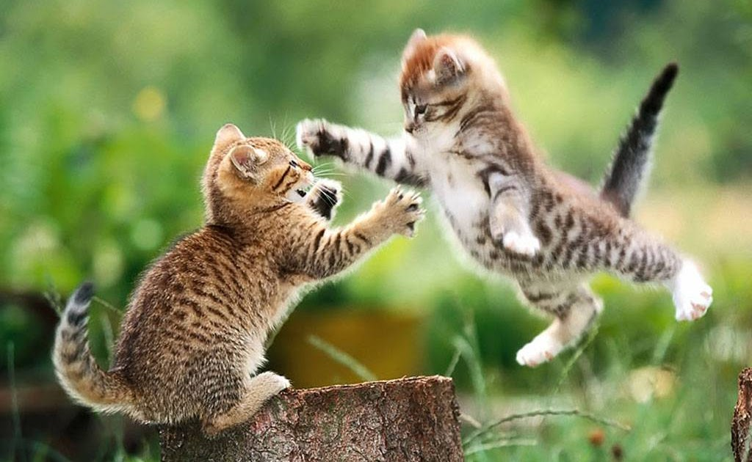

Steganography
This is message!
This is message!

